Slide 1
The Naming Principles of Novel Cultural Items: A Perspective from the Spice Domain
Gábor Parti, Chu-Ren Huang The Hong Kong Polytechnic University
The 31st Joint Workshop on Linguistics and Language Processing ISLI (Institute for the Study of Language and Information), Kyung Hee University
2022. 12. 16.
Notes:
Good afternoon, everyone, my name is Gabor Parti, and I am a final year PhD student from the Hong Kong Polytechnic University. The title of my talk is: The Naming Principles of Novel Cultural Items: A Perspective from the Spice Domain. CLICK

Slide 2
Overview
Introduction
Methods
Analysis
Case study
Conclusion

Slide 3
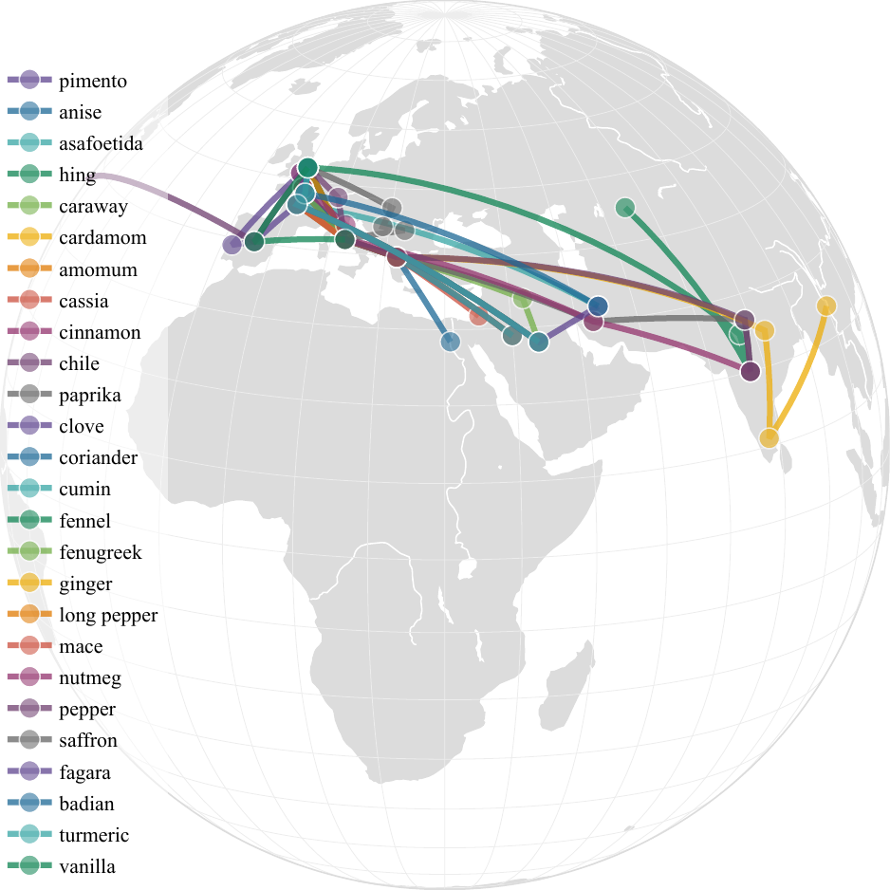
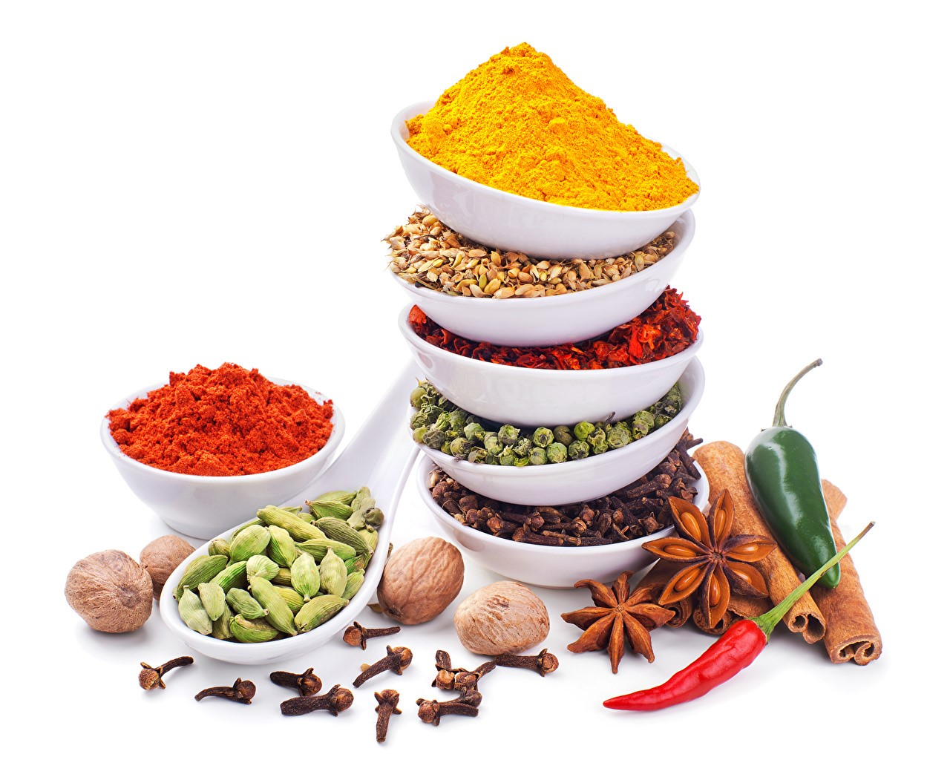
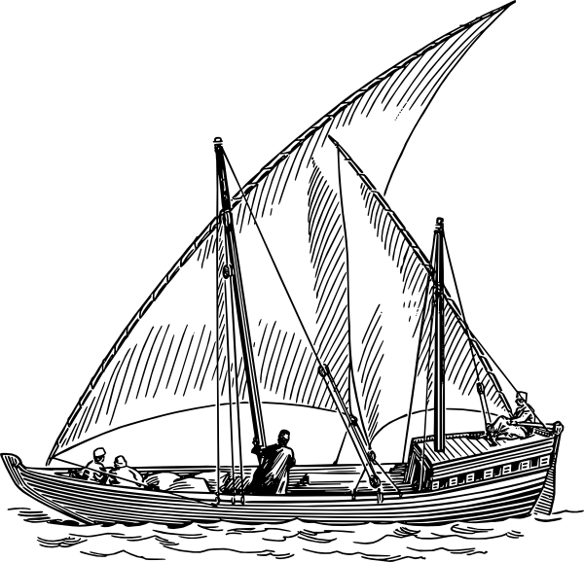
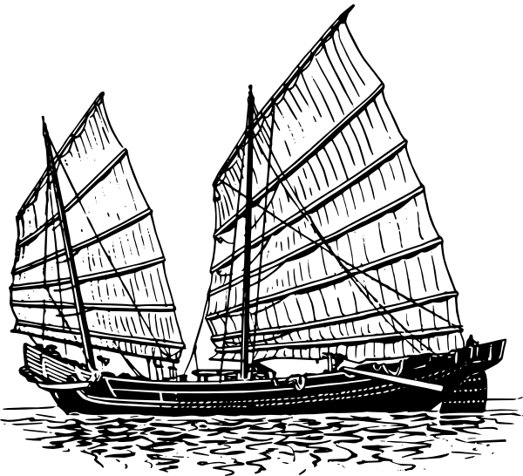
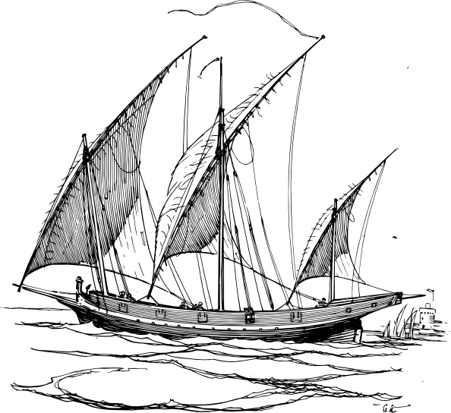
Introduction
Part of a thesis project: Mapping the Language of Spices
Research on the spice domain by examining spice nomenclature:
Linguistic diffusion of the products and their terminology.
Desired aromatic substances, easy to trade
Set of materials – set of names
Notes:
Today I am going to introduce to you a segment of my dissertation, the title of which is Mapping the Language of Spices.
My research is about spices and spice names, and their geographic and linguistic spread and diffusion (including both the products and the terminology).
To introduce very briefly, these substances were highly desired for there fragrance and aroma, and they were also easy to transport because they were made up of dried plant parts light in weight.
Consequently, spices and their names have spread far and wide around the globe via historic trade networks, for thousands of years now, and we can trace the journey of the materials by following the trail of their names.
The most important premise here as that we not only have a set of materials, but also a set of names to examine.

Slide 4
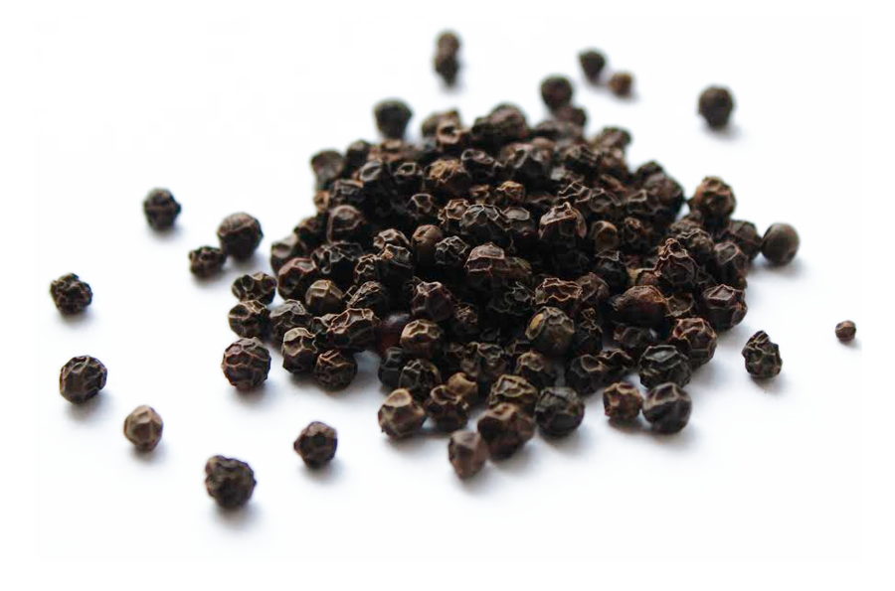
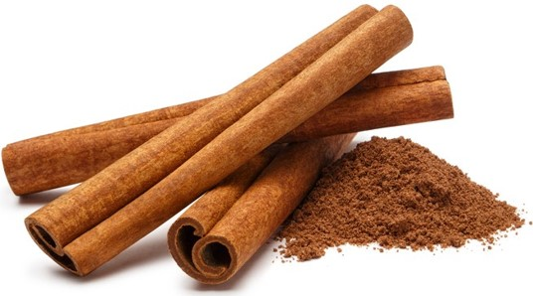
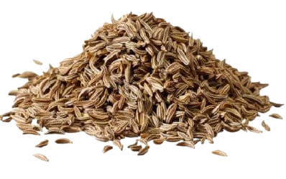
Loanwords & Wanderwörter
cinnamon
cardamom
cumin
pepper
قرفة
كمون
فلفل
هال
？
肉桂
孜然
椒
豆蔻
Notes:
During my research I have come across names, such as ... … Jiāo, ròuguì, dòukòu, zīrán. Not surprisingly, we can see that this domain is very rich in loanwords and Wanderwörter or wandering loanwords, that have spread across large areas and into many languages.

Slide 5
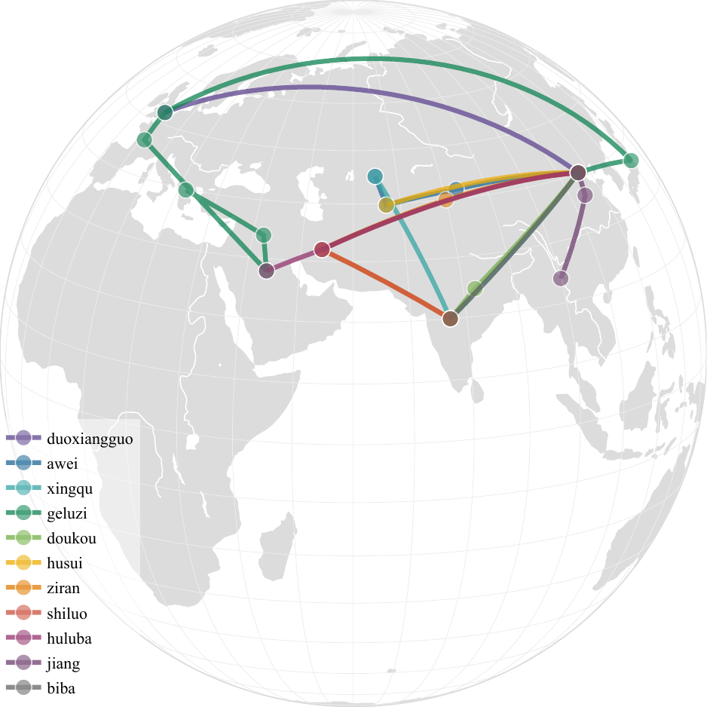
Mapping the etymologies
English
Arabic
Chinese
Notes:
What I did for one, is that I have mapped the etymologies for the three languages, which in turn showed the most influential donor languages and the civilizations that participated in the spice trade along trade routes.

Slide 6
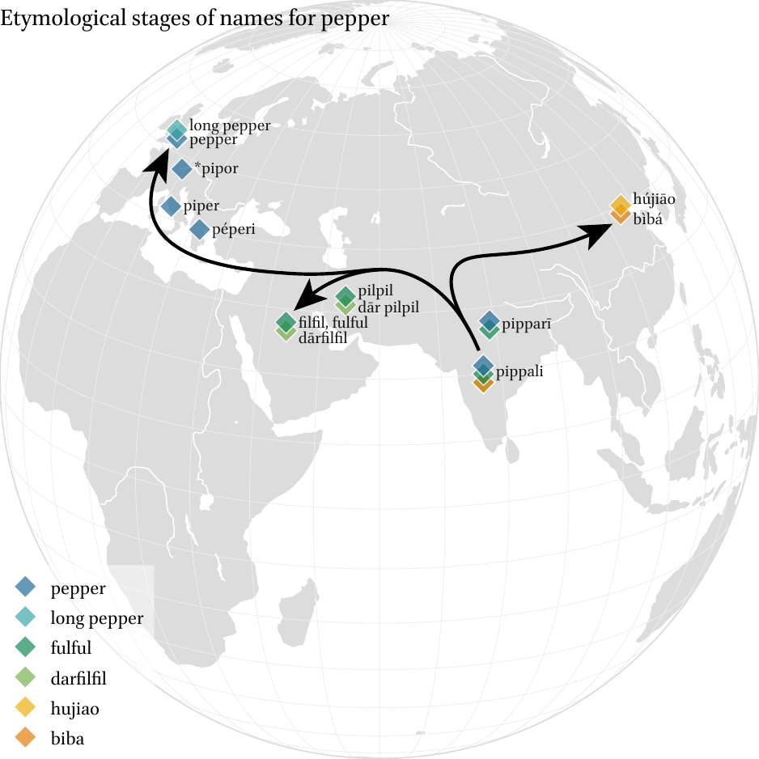
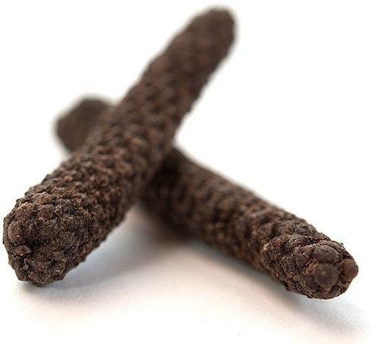
black pepper
Diffusion of words for pepper
piper, فلفل fulful, 蓽茇 bìbá, etc.
from Sanskrit पिप्पलि pippali
‘long pepper’
Notes:
On a more concrete example, here you can see for example the diffusion of words for pepper from Sanskrit pippali, which is the etymon of many pepper words across languages, especially by transmissions via Greek in Latin in Europe, Arabic and Persian in West Asia, and Sanskrit in East Asia. Interestingly, the original word referred to long pepper, not black pepper, which is a related but different spice also from India. Chinese biba used in Traditional Chinese Medicine still refers to this fruit. Okay, so far so good.

Slide 7
Ceylon cinnamon
black cumin
Jamaica pepper
true cardamom
قرفة سيلانية
كمون أسود
فلفل إفرنجي
هال حقيقي
錫蘭肉桂
阿拉伯茴香
牙買加胡椒
綠豆蔻
Ethiopian false cardamom
Javanese long pepper
red hot chili pepper
Notes:
Now, here it gets tricky: We have many compounded names as well, that clearly point to other items, for example Jamaica pepper, Ceylon cinnamon, true cardamom, black cumin, and even more complex cases, such as Javanese long pepper, Ethiopian false cardamom, or red hot chili pepper. What’s going on here? Today we are going to untangle this phenomenon.

Slide 8
Introduction: The Borrowed Elements
The distribution of borrowed spice names:
What are the non-borrowed spice names, and how do they emerge?
Notes:
My project focuses on English, Arabic, and Chinese, and here you can see the distribution of borrowed spices names according to the default names of 24 spices in my dataset. What you can see here is a hint on that while English and Arabic mostly borrows spice names, Chinese prefers native solutions. CLICK. But what are these native solutions? What are the non-borrowed elements in spice name creation?

Slide 9
Introduction:
When investigating the linguistic phenomena around the exchange of words along with items of trade in contact situations, we have a good understanding of how borrowing happens.
Linguistic acculturation (Cambell & Mixco, 2007)
“response in a language to new items that become known through cultural contact”
names of novel items, that were not simply borrowed, but “innovated”
Notes:
When investigating the linguistic phenomena around the exchange of words along with items of trade in contact situations, we already have a good understanding of how borrowing happens.
In this talk, I will try to approach the same event – linguistic acculturation, the “response in a language to new items that become known through cultural contact” (Cambell & Mixco, 2007) – but focus on words, specifically the names of novel items, that were not simply borrowed, but otherwise “innovated”.

Slide 10
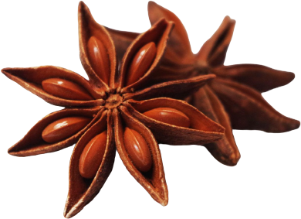
Mechanisms of linguistic acculturation
Is a name borrowed or not, and if not, how did speakers come up with the name?
Borrow
Loan – anise (ultimately from Ancient Greek)
Calque (loan translation) – long pepper (from Latin Piper longum)
Learned loans – asafoetida – from Late Latin medicinal terminology
Innovate
Compounding (internal resources) – black cardamom; sweet cumin; etc.
Blending – aniseed; safflower
Shift
Narrow, broaden, displace – pimento ‘pigment’ → ‘spice’; pebre displaced by pimento
Extend
Metonymy – octagon → 八角 bājiǎo [eight-horn] ‘star anise’
Metaphor – black gold ‘black pepper’; devil’s dung ‘asafoetida’
Notes:
The mechanisms of linguistic acculturation can be several, and they can be deducted from linguistic (and historical) analysis.
The main question for a linguists is: Is a name borrowed or not, and if not, how speakers came up with the name?
So, languages can either borrow loanwords, such as anise in English, calque loan translations, such as long pepper from Latin, they can borrow indirectly, such as the learned loan of asafoetida from medieval medical texts, but they can also innovate using internal resources through compounding, black cardamom; sweet cumin, blending: aniseed; safflower, and the meaning can shift with time, for example the word pigment for paints and dyes in Romance languages broadened to include concoctions of plant matter and eventually spices, then narrowed down to mean pepper, and today Spanish pepper is called pimento. Also, this new word have displaced the older word, pebre ‘pepper’ which was the Greek loan we still have in most European languages.

Slide 11
Introduction: Questions
Intuitively, a community either borrows or creates a name.
How?
How do people name new spices?
What are the mechanisms of the naming process?
What are the forces behind spice name propagation/generation?
How a typical spice name looks like?
Notes:
Intuitively, a community either borrows or creates a name. But how?
The questions then are: How do people name spices, and specifically, new spices that they encounter? What are the underlying mechanisms of the naming process when adopted by a community? And what are the forces behind spice name propagation/generation? How does a typical spice name looks like?

Slide 12
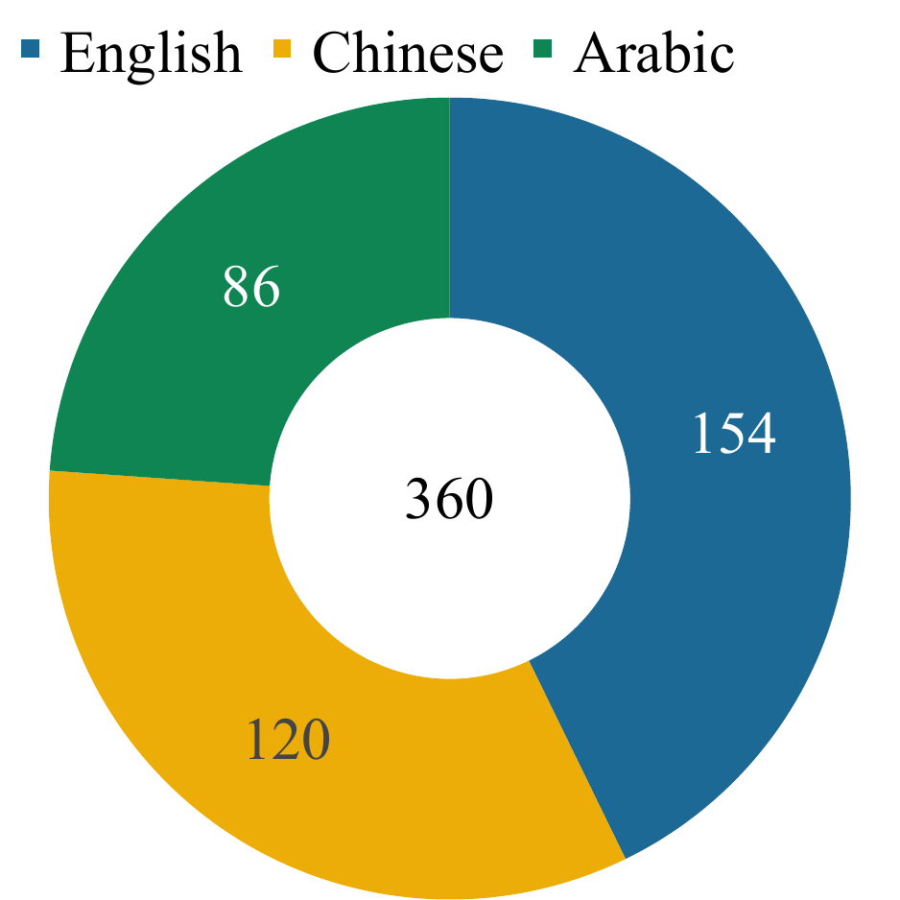
Methods
Data collection
360 names
24 spices
3 languages
Analysis
structure, mechanism, motivation, etc.
Notes:
During my research I have collected 360 spice names for 24 spices using dictionaries, corpora, primary sources and secondary literature on spices, and analyzed them. On the right you can see the distribution of the names I collected in the three languages.

Slide 13
Analyzability
Unanalyzable (monomorphemic), semi-analyzable, or analyzable
e.g.: cinnamon vs. true cinnamon, Ceylon cinnamon; Chinese cinnamon nutmeg
Spice names are mostly analyzable.
Notes:
First things first, we must decide if a name is analyzable or not. Cinnamon to an English speaker is unanalyzable, because the word cannot be broken down to smaller parts, and it does not convey any other meaning than the primary sense of cinnamon. However, the name true cinnamon is analyzable. Analyzable words are mostly compounds in all three languages, or derivations in case of inflecting languages, such as Arabic. A semi-analyzable names are often so-called ‘cranberry’ words, a good example would be nutmeg, where the morpheme ‘nut’ has a meaning discernable to the English reader, while ‘meg’ has no apparent sense. Most unanalyzable words are loanwords.
According to my dataset, spice names are mostly analyzable.
(((Analysability of words is an idea from a 19th century philological movement Wörter und Sachen (words and things), which proposed the close study of etymology of words together with the artifacts/concepts. Basically, the more opaque a name is in terms of morphological analysis, the longer it is assumed to be present in the language. The usual example is York vs. New York.)))

Slide 14
Structure
The distribution of structure among spice names:
Spice names are overwhelmingly compounded.
Notes:
By structure, spice names are overwhelmingly compounded, with some monomorphemic and a very few occasional cases of phrases and derived terms. By derived terms here I mean Arabic spice words devised from other Arabic words using the magic of inflectional morphology.
(((devil’s dung)))

Slide 15
Finding a Blueprint
headword + modifier
Saigon cinnamon; Java long pepper; bastard saffron, etc.
Headwords point to prototype spices; modifiers point to a distinguishing features:
salient features (of appearance, taste), historical clues, and motivations
prototypes:
chili pepper; star anise; Roman cumin; new spice, true cardamom, etc.
distinguishers:
hot pepper; Frankish pepper; allspice; Tibetan saffron; yellow ginger, etc.
Notes:
The first obvious thing I have noticed is that analyzable, compound spice names have a blueprint, a very typical structure: they need a headword and a modifier, where modifiers can be multiple. The role of the two components is also very clear:
Usually, a headword is a prototype name pointing to a prototype spice, they tie the product to something that people already know. A modifier is some sort of distinguisher adding an interesting layer: these words carry extra information about salient features, historical clues, and motivations behind the naming.
For example, prototypes are READ.

Slide 16
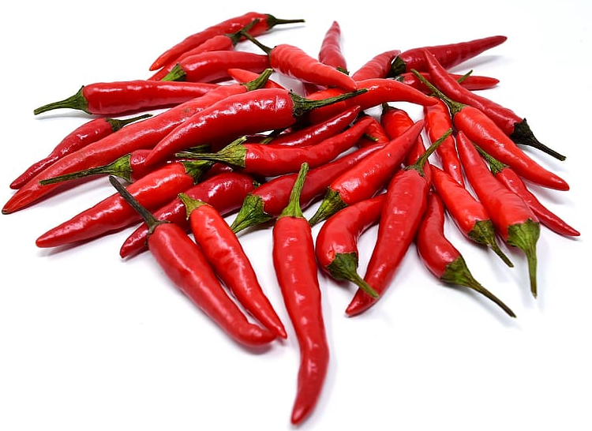
Headword type (top 5)
Prototype words are often used “falsely” for a new cultural item they have no previous connection to.
E.g., the pepper in black pepper is “true”, but in chili pepper it is not (botanically, etymologically not related) – misnomers, e.g.: pimento de la India (Indian pepper) ‘chili’
Prototypes are used for their similarity to their new substance: physical appearance (shape, size, color), chemical (scent, flavor); and function (cooking, dyeing, medicinal).
Notes:
Let’s see how can we categorize these components. First, we look at the headwords. You can see that I have distinguished prototype and prototype similarity.
This is most interesting: prototype words are often used “falsely”; in the sense that they are used for items that only resemble the prototype items in some way but do not actually match the referents. Let me explain.
For example, the pepper in black pepper is true, they refer to the same Old World peppercorns, but pepper in chili pepper it is not (botanically or etymologically not related), the only reason we call the red American chilies nowadays as “pepper” is the Spanish explorers’ own conviction.
Similar cases have created lots of misnomers that are perfectly accepted and widespread nowadays, but the most famous example is the double misnomer of Indian pepper, after Columbus’s belief that he was somewhere near India. Of course, the Spanish did not confuse chilies with black peppers, they knew perfectly well what they were looking for, they just used the prototype word in their language for the prototype spice they knew to refer to the new fruits, due to their similarity in function. By the way, we also have a native Central American word for the New World hot peppers: chili from Classical Nahuatl.
In short, prototypes are used for their similarity to their new substance: physical appearance in shape, size, and color;, chemical composition supplying scent and flavor; and their everyday functions and roles, such as culinary, dye, or medicine.
The most prominent factor in naming a novel spice after a prototype is in the similarity of their looks.

Slide 17
Modifier type (top 5)
Modifiers use the salient features of an item to distinguish it from others
Geographical origin, colour, shape, taste, authenticity, etc.
E.g.: cinnamon vs. Chinese cinnamon; anise vs. star anise; cardamom vs. black cardamom; saffron vs. bastard saffron
Notes:
As for the modifiers, these words refer to salient features of an item to distinguish it from others, for example by: geographical origin, colour, shape, taste, positive or negative authenticity, or other descriptive words.

Slide 18
Sensory modalities
Modifiers are rich in sensory words of color, taste, and smell
red, sweet, stinking, hot, numbing…
The distribution conforms to our (Aristotelian) understanding of the senses: higher senses > lower senses
Notes:
Very often, modifiers are sensory words referring to color, shape, taste, or smell, such as “red, sweet, stinking, hot, numbing…”, Thethat you can see here mostly conforms to our (Aristotelian) understanding of the senses: where higher senses of vision is more prevalent thatn the > lower senses of taste, smell, and touch.

Slide 19
Motivation
Practical reasons:
identify (star anise, Sichuan pepper)
distinguish (long pepper, black cardamom)
advertise (grains of paradise, true cinnamon)
Notes:
The motivations behind the naming of new spices are guided by practical reasons: To identify and to distinguish, although the line is very blurry between the two. There are some names also clearly intended to sell more of these gifts of paradise.

Slide 20
Case studies

Slide 21
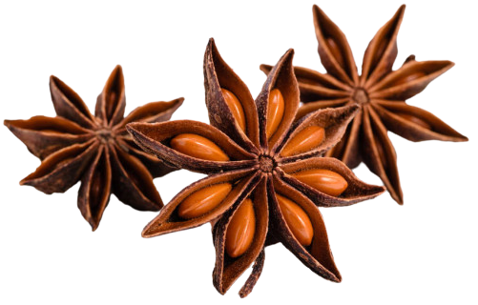
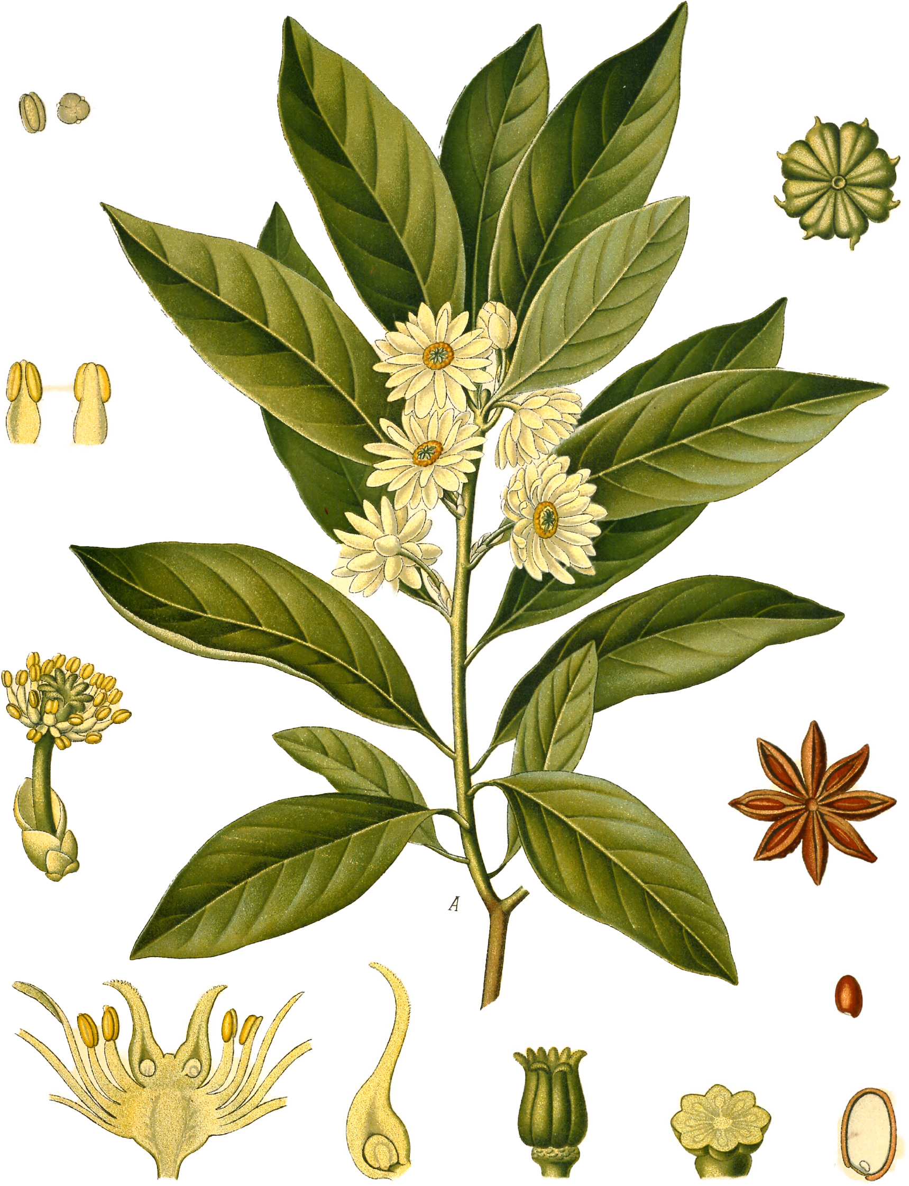
Example 1. Illicium verum Hook.f. star anise ● 八角 ● ينسون نجمي ● csillagánizs
language | script | name | literal
Chinese | 八角茴香 | bājiǎo- huíxiāng | octagonal fennel
English | N/A | star anise | star anise
Arabic | ينسون نجمي | yansūn najmī | star anise
Native or borrowed?
The Chinese name is a native Chinese lexical creation,
English and Arabic used a non-native headword:
anise, a loanword ultimately from Greek (and maybe Egyptian), and a native modifier: ‘star’
Notes:
Let’s see how to apply this type of analysis, on a spice that probably everyone knows, or at least have seen before.
Here you can see the names of star anise in 3 languages, star anise is the fruit of a tree native to Vietnam and South China.
The Chinese name is a native Chinese lexical creation,
English and Arabic used a non-native headword: anise, a loanword ultimately from Greek and a native modifier: ‘star’. These cases are considered not-borrowed, as they were created in the recipient language, even if using foreign materials. (WOLD) https://wold.clld.org/

Slide 22
Example 1. Illicium verum Hook.f. star anise ● 八角 ● ينسون نجمي ● csillagánizs
language | script | name | literal | analyzability
Chinese | 八角茴香 | bājiǎo- huíxiāng | octagonal fennel | analyzable
English | N/A | star anise | star anise | analyzable
Arabic | ينسون نجمي | yansūn najmī | star anise | analyzable
These names are analyzable.
The analysability of words is an idea from a 19th philological movement, which proposed the close study of etymology of words together with the artifacts/concepts.
Basically, the opaquer a name is in terms of morphological analysis, the longer it is assumed to be present in the language. E.g.: York (monomorphemic) vs. New York (analysable) → provides a potential chronology!
Notes:
These names are analyzable. The analysability of words is an idea from a 19th philological movement Wörter und Sachen (words and things), which proposed the close study of etymology of words together with the artifacts/concepts. Basically the more opaque a name is in terms of morphological analysis, the longer it is assumed to be present in the language. E.g.: York (monomorphemic) vs. New York (analysable) → provides a potential chronology
Incorporated into historical linguistics ( + archeology)

Slide 23
Example 1. Illicium verum Hook.f. star anise ● 八角 ● ينسون نجمي ● csillagánizs
language | script | name | literal | analyzability | structure
Chinese | 八角茴香 | bājiǎo- huíxiāng | octagonal fennel | analyzable | compound
English | N/A | star anise | star anise | analyzable | compound
Arabic | ينسون نجمي | yansūn najmī | star anise | analyzable | compound
These names are compound.

Slide 24
Example 1. Illicium verum Hook.f. star anise ● 八角 ● ينسون نجمي ● csillagánizs
language | script | name | literal | analyzability | structure | mechanism
Chinese | 八角茴香 | bājiǎo- huíxiāng | octagonal fennel | analyzable | compound | extension (metonymy)
English | N/A | star anise | star anise | analyzable | compound | innovation
Arabic | ينسون نجمي | yansūn najmī | star anise | analyzable | compound | innovation (calque?)
Depends…
The names are (most likely) native innovations using internal resources.
Notes:
And the mechanisms are most likely native creations…but it is possible that the Arabic name was influenced by another language. As of now, I do not have a proof of attestation, so we cannot know for sure.

Slide 25
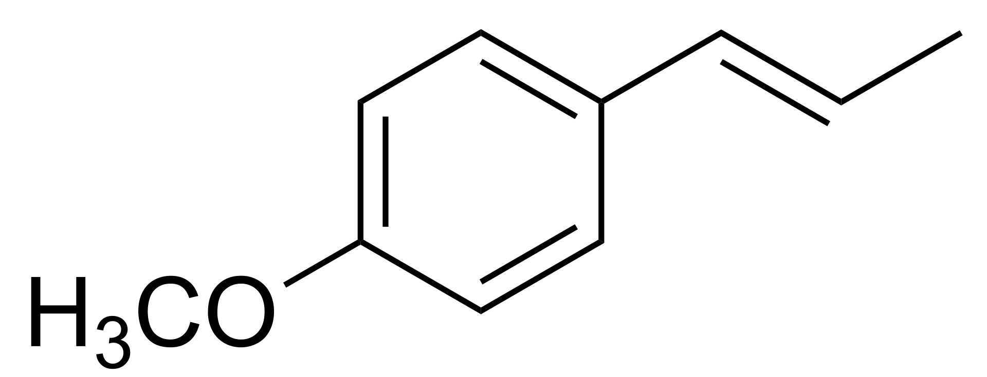
Example 1. Illicium verum Hook.f. star anise ● 八角 ● ينسون نجمي ● csillagánizs
language | script | name | literal | analyzability | structure | mechanism | headword
Chinese | 八角茴香 | bājiǎo- huíxiāng | octagonal fennel | analyzable | compound | extension (metonymy) | prototype similarity (taste)
English | N/A | star anise | star anise | analyzable | compound | innovation | prototype similarity (taste)
Arabic | ينسون نجمي | yansūn najmī | star anise | analyzable | compound | innovation? calque? | prototype similarity (taste)
The headwords are using a prototype spice, pointing to anise and fennel, two spices that originate in the Mediterranean and West Asia, and have similar flavor profiles to star anise.
Now we know that in fact they do indeed have the same dominant chemical compound, anethole.
Notes:
…responsible for the same taste and smell. The modern food industry substitutes star anise oil for anise liqeurs.

Slide 26
Example 1. Illicium verum Hook.f. star anise ● 八角 ● ينسون نجمي ● csillagánizs
language | script | name | literal | analyzability | structure | mechanism | headword | modifier
Chinese | 八角茴香 | bājiǎo- huíxiāng | octagonal fennel | analyzable | compound | extension (metonymy) | prototype similarity (taste) | shape
English | N/A | star anise | star anise | analyzable | compound | innovation | prototype similarity (taste) | shape
Arabic | ينسون نجمي | yansūn najmī | star anise | analyzable | compound | innovation? calque? | prototype similarity (taste) | shape
The modifiers all highlight the spice’s unique shape (the pericarps of star anise).
But…
Notes:
The modifiers all highlight the spice’s unique shape (the pericarps of star anise).

Slide 27
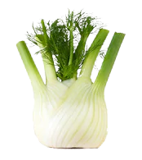
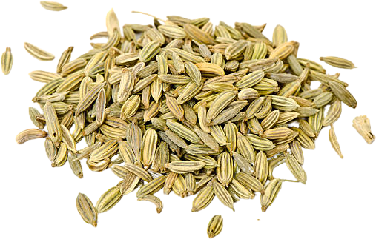
Example 1. Illicium verum …more
language | script | name | literal | modifier | headword | modifier type | headword type
Chinese | 八角 | bājiǎo | octagonal | - | bajiao | - | shape
Chinese | 八角茴香 | bājiǎo huíxiāng | octagonal-fennel | bājiǎo ‘octagocal’ | huíxiāng | shape | prototype similarity (taste)
Chinese | 大茴香 | dà​huíxiāng | big-fennel | dà ‘big’ | huíxiāng | size | prototype similarity (taste)
Chinese | 大料 | dà​liào | big-ingredient | dà ‘big’ | ​liào | size | function
English | - | star anise | - | star | anise | shape | prototype similarity (taste)
English | - | Chinese anise | - | Chinese | anise | origin | prototype similarity (taste)
English | - | Chinese star anise | - | star; Chinese | anise | shape + origin | prototype similarity (taste)
English | - | badian | - | - | badian | - | borrowing
Arabic | ينسون نجمي | yansūn najmī | star anise | najmī `star’ (adj.) | yansūn | shape | prototype similarity (taste)
native spice
大/小 dà/xiǎ ‘greater/lesser’
Notes:
Star anise have various other name variations. Can we analyze them?
Chinese has a modifier of size (‘big’), which implies that there is a 小茴香 xiaohuixiang, ‘small’ huixiang. There is indeed, it is fennel. In fact, the Chinese 大/小 dà/xiǎ ‘greater/lesser’ contrast is not necessarily a marker of size, but a semantic tool to convey unmarked/marked, or proper/imitator.

Slide 28
Follow the trail…
八角茴香 → the “official name” used in TCM.
What is 茴香? Fennel.
大茴香 ‘big’ → is there 小茴香 ‘small’?
Yes, it also refers to fennel (TCM).
What is the relationship between the two?
Mentioned among other spices in Chinese medicinal literature, 茴香 first appears in Tang (618 to 907).
In every dictionary and source, 茴 is fennel or “aniseed”, also found in names of cumin, caraway, and dill.
Kangxi dictionary (1716) mentions 野茴香 ‘dill’; 小茴香 ‘fennel’; others 茴芹 ‘anise’; 藏茴香 [Tibetan fennel] ‘caraway’; 安息茴香 [Parthian fennel], 阿拉伯茴香 [Arabian fennel] ‘cumin’ (孜然).

Slide 29
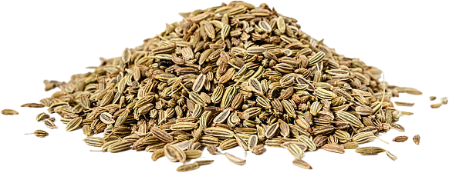
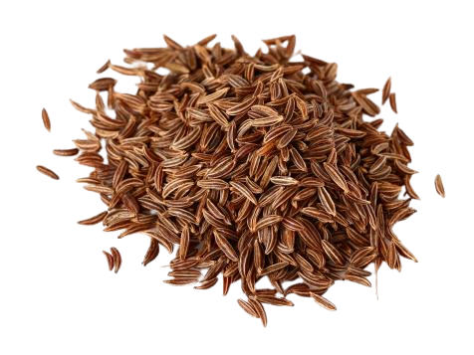
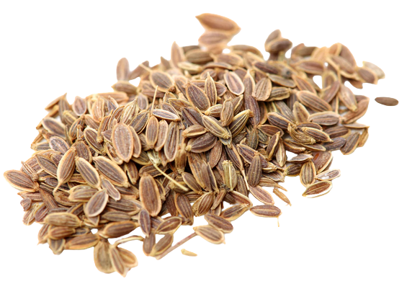
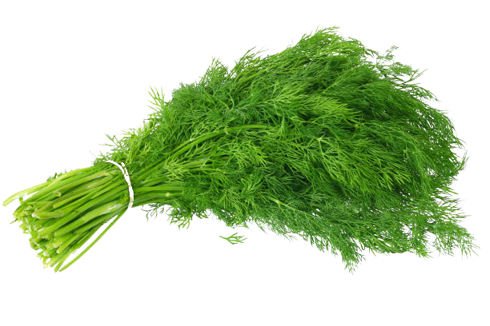
Pimpinella anisum anise 茴芹
Foeniculum vulgare fennel 茴香
Cuminum cyminum cumin 孜然
Carum carvi caraway 葛缕子,藏茴香
Anethum graveolens dill 蒔蘿

Slide 30
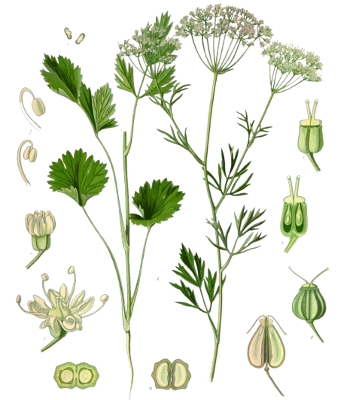
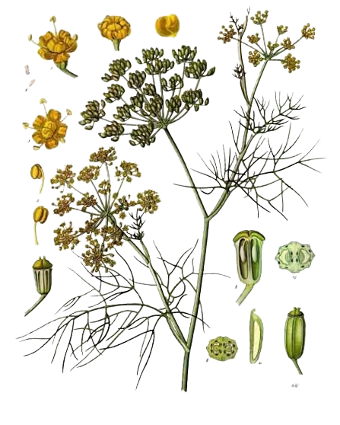
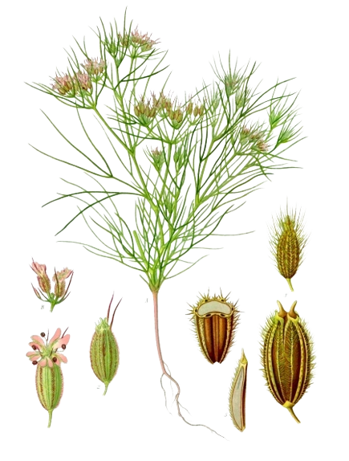
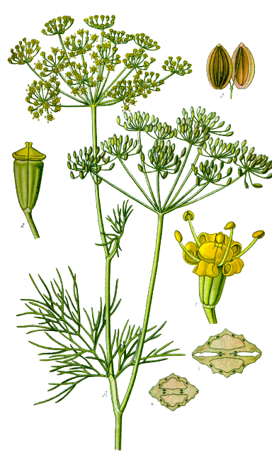
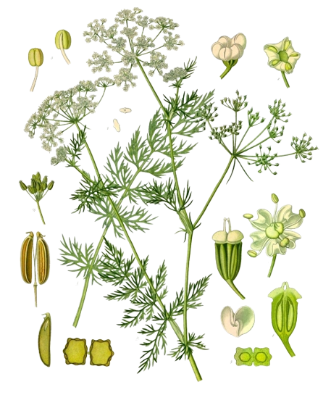
Pimpinella anisum anise 茴芹
Foeniculum vulgare fennel 茴香
Cuminum cyminum cumin 孜然
Carum carvi caraway 葛缕子, 藏茴香
Anethum graveolens dill 蒔蘿
Herbaceous, small shrubs

Slide 31
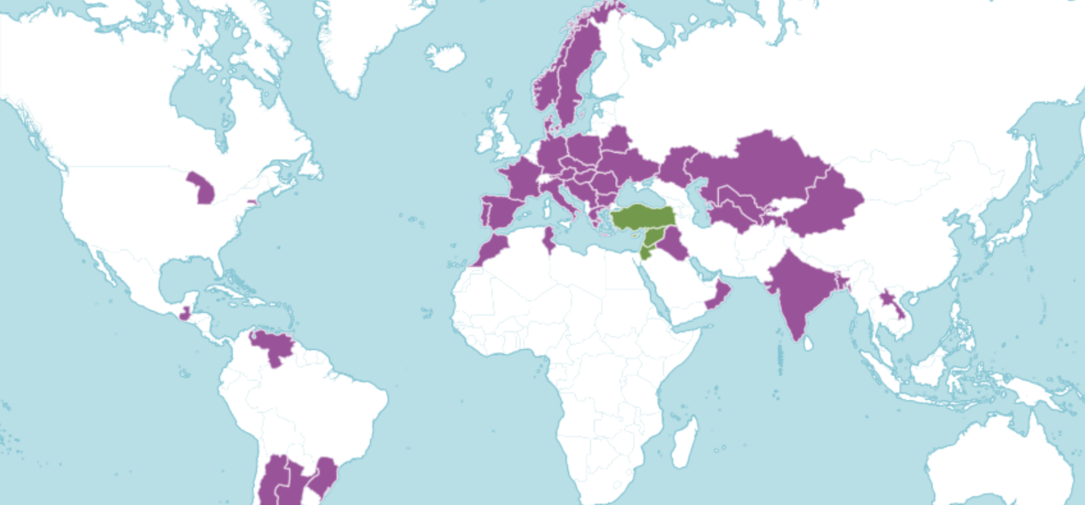
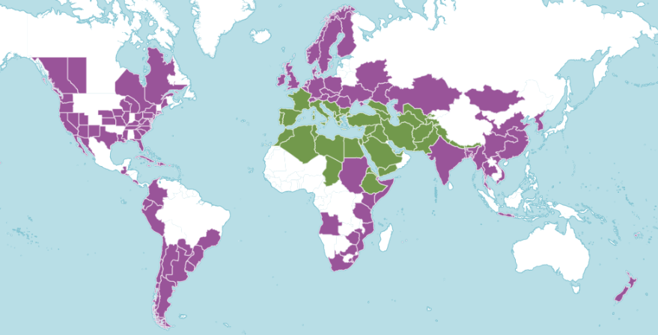
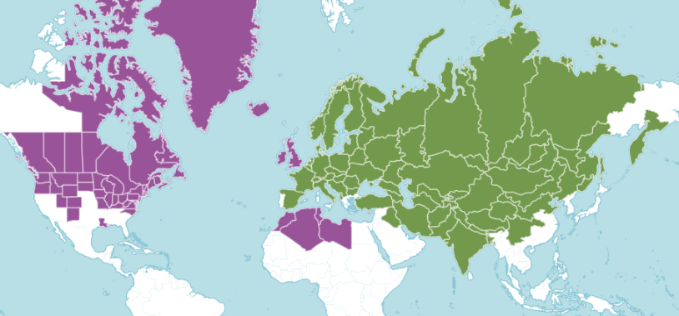
Pimpinella anisum anise 茴芹
Foeniculum vulgare fennel 茴香
Cuminum cyminum cumin 孜然
Carum carvi caraway 葛缕子, 藏茴香
Anethum graveolens dill 蒔蘿

Slide 32
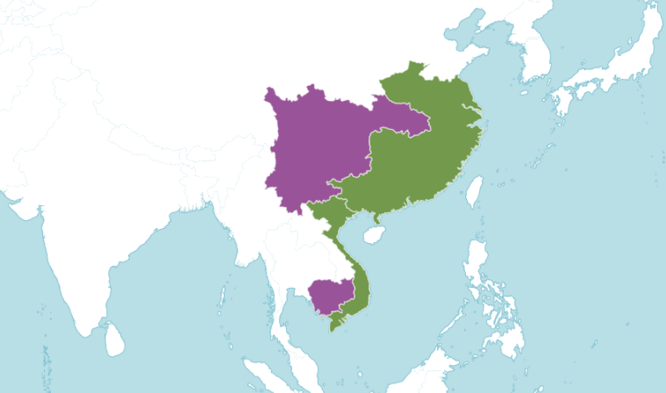
Illicium verum star anise 八角

Slide 33
Botanical insights:
Star anise is native to South China and Vietnam, anise and fennel is native from Mediterranean to West Asia until the Himalayas.
Star anise has been used for around 3000 years (in and around the South, only later in the North), no longer found in the wild.
The other plants I mentioned are all related to fennel, all are from the Apiaceae, the carrot/celery/parsley family.
They all look similar and are used similarly and named after each other in many languages.
All these plants arrived from the west through Central Asia and the Silk Road.
This is reflected in some of the names.
What’s the connection between anise, star anise and fennel?
Anethole – similar flavor profiles because of the same essential oil

Slide 34
Cultural insights
Both fennel and star anise are essential part of Chinese culture and cuisine for long time, e.g., 五香粉 five spice powder.
Fennel must have arrived from Central Asia.
Islam reached China in the 7th century from the Silk Road, also spices.
Some foreign traders were called Hui(hui):
Kubilai Khan: “Musuluman [Muslim] Huihui and Zhuhu [Jewish] Huihui”;
Ming times: Muslims (White Hui), Persian Christians (Black Hui) and Jews (Blue Hui);
回 character refers to Islam and the Hui people of northwest China.
My theory: 艹 (艸) ‘grass’ + 回 Hui → 茴 …not attested, need to prove. Is it possible?
Star anise is a late addition to the European kitchen, an English pirate Sir Thomas Cavendish brought it to Europe from the Philippines in 1588.
rare

Slide 35
caraway
fennel
anise
dill
cumin
star anise
1588

Slide 36
Conclusions
Spice names are usually created along a specific blueprint of
headword + modifier
The most typical is pattern of which is:
geographic origin + prototype similarity
Due to the highly sensory nature of these cultural items, the most featured sensory modalities are vision, then gustation and olfaction.
We can understand the names by studying historical and botanical cues, and vice versa the names can show us new cultural insights.

Slide 37
Thank you!
Notes:
Thnak you so much for allowing me to talk here today, if you have any question, please feel free to ask!

Slide 38
References I.
Alrabiah, M., Al-Salman, A., & Atwell, E. S. (2013). The design and construction of the 50 million words KSUCCA 2nd Workshop on Arabic Corpus Linguistics, Lancaster University, UK.
Austin, D. F., & Felger, R. S. (2008). Sichuan Peppers and the etymology of Fagara (Rutaceae). Economic Botany, 62(4), 567-573. http://www.jstor.org/stable/40390390
Bearman, P. J., Bianquis, T., Bosworth, C. E., Donzel, E. v., & Heinrichs, W. P. (Eds.). (1960–2005). The Encyclopaedia of Islam (2 ed.). E. J. Brill.
Blythe, R. A., & Croft, W. (2012). S-curves and the mechanisms of propagation in language change. Language, 88(2), 269-304. http://www.jstor.org/stable/23251832
Boy, H. I. A., Rutilla, A. J. H., Santos, K. A., Ty, A. M. T., Yu, A. I., Mahboob, T., Tangpoong, J., & Nissapatorn, V. (2018). Recommended medicinal plants as source of natural products: A review. Digital Chinese Medicine, 1(2), 131-142. https://doi.org/10.1016/s2589-3777(19)30018-7
Burnet, I. (2011). Spice Islands. Rosenberg Pub.
Casson, L. (1989). The Periplus Maris Erythraei: Text with introduction, translation, and commentary. Princeton University Press.
Corn, C. (1998). The scents of Eden: A narrative of the spice trade. Kodansha International.
Craze, R. (2008). The spice companion: The essential guide to using spices for your health and wellbeing. People's Medical Society.
Czarra, F. R. (2009). Spices: A global history. Reaktion Books.
Dalby, A. (2001). Christopher Columbus, Gonzalo Pizarro, and the search for cinnamon. Gastronomica, 1(2), 40-49. https://doi.org/10.1525/gfc.2001.1.2.40
Dalby, A. (2002). Dangerous tastes: The story of spices. University of California Press.
Depner, S. C.-y. (2019). Chinese language and fruits. In C.-R. Huang, Z. Jing-Schmidt, & B. Meisterernst (Eds.), The Routledge Handbook of Chinese Applied Linguistics (pp. 92-104). Routledge.
Dott, B. R. (2020). The chile pepper in China: A cultural biography. Columbia University Press.
Duke, J. A. (2002). CRC handbook of medicinal spices. CRC press.
Española, Real Academia. (2014). Diccionario de la lengua española. https://dle.rae.es
Fellbaum, C. (1998). Wordnet: An electronic lexical database. MIT Press.
Freedman, P. (2008). Out of the East: Spices and the medieval imagination. Yale University Press.
Freedman, P. (2015). Health, wellness and the allure of spices in the Middle Ages. Journal of Ethnopharmacology, 167, 47-53. https://doi.org/https://doi.org/10.1016/j.jep.2014.10.065
Goddard, C., & Wierzbicka, A. (2014). Words and meanings: Lexical semantics across domains, languages, and cultures. Oxford University Press.
Guthrie, W. B. (2009). The trade-language origin of "turmeric". Word (Worcester), 60(1), 79-90. https://doi.org/10.1080/00437956.2009.11432594
Haw, S. G. (2017). Cinnamon, cassia and ancient trade. Journal of Ancient History and Archaeology, 4(1), 5-18. https://doi.org/10.14795/j.v4i1.211
Jakubíček, M., Kilgarriff, A., Kovář, V., Rychlý, P., & Suchomel, V. (2013). The TenTen corpus family. 7th International Corpus Linguistics Conference (CL2013), Lancaster University.
Jurafsky, D. (2014). The language of food: A linguist reads the menu. W.W. Norton & Company.

Slide 39
References II.
Keay, J. (2006). The spice route: A history. University of California Press.
Kilgarriff, A., Baisa, V., Bušta, J., Jakubíček, M., Kovář, V., Michelfeit, J., Rychlý, P., & Suchomel, V. (2014). The Sketch Engine: Ten years on. Lexicography, 1(1), 7-36.
Krondl, M. (2007). The taste of conquest: The rise and fall of the three great cities of spice. Ballantine Books.
Kurlansky, M. (2002). Salt: A world history. Walker and Co.
Lakshmi, P. (2016). The encyclopedia of spices and herbs: An essential guide to the flavors of the world.
Lane, E. W., & Lane-Poole, S. (1863-1893). An Arabic-English lexicon: Derived fom the best and the most copious Eastern sources. Williams and Norgate.
Leung, A. K. C., & Chen, M. (2019). The Itinerary of Hing/Awei/Asafetida across Eurasia, 400–1800. In P. H. Smith (Ed.), Entangled Itineraries: Materials, Practices, and Knowledges across Eurasia (pp. 141-164). University of Pittsburgh Press. https://doi.org/10.2307/j.ctvh9vzc1.10
Lewis, C. T., & Short, C. (1958). A Latin dictionary: Founded on Andrews' edition of Freund's Latin dictionary, revised, enlarged, and in great part rewritten. Clarendon Press.
Liu, Z., Gao, M., Mai, Y., & Youwei, S. (Eds.). (1985). 漢語外來詞詞典 [Dictionary of Chinese loanwords]. 商務印書館香港分館 [The Commercial Press Hong Kong Branch].
Macdonell, A. A. (1929b). A practical Sanskrit dictionary with transliteration, accentuation, and etymological analysis throughout. Oxford University Press. https://dsal.uchicago.edu/dictionaries/macdonell/
Mair, V. H., & Hoh, E. (2009). The true history of tea. Thames & Hudson.
Meisterernst, B. (2019). Chinese language and the Silk Roads. In The Routledge Handbook of Chinese Applied Linguistics (pp. 61-79). Routledge.
Miller, G. A. (1995). WordNet: A lexical database for English. Communications of the ACM, 38(11), 39-41.
Milton, G. (1999). Nathaniel's Nutmeg: Or, the true and incredible adventures of the spice trader who changed the course of history. Farrar, Straus and Giroux.
Monier-Williams, M. (1899). A Sanskrit-English Dictionary: Etymologically and Philologically Arranged with Special Reference to Cognate Indo-European Languages. Clarendon Press.
Morton, T. (2006). The poetics of spice: Romantic consumerism and the exotic. Cambridge University Press.
Nabhan, G. P. (2014). Cumin, camels, and caravans: A spice odyssey. University of California Press. http://www.jstor.org/stable/10.1525/j.ctt7zw251
Nugent-Head, J. (2014). The first Materia Medica: The Shen Nong Ben Cao Jing. Journal of Chinese Medicine(104).
O'Connell, J. (2016). The book of spice: From anise to zedoary. Pegasus Books.
Parthasarathi, P. T. (2015). Roman control and influence on the spice trade scenario of Indian Ocean world: A re‐assessment of evidences. Heritage: Journal of Multidisciplinary Studies in Archaeology, 3.
Parthasarathy, V. A., Chempakam, B., & Zachariah, T. J. (2008). Chemistry of spices. CABI.
Peter, K. V. (2012). Handbook of Herbs and Spices (2 ed.). Woodhead Publishing Limited. http://www.sciencedirect.com/science/book/9780857090409
Polomé, E. C. (1990). Research guide on language change. Mouton de Gruyter.

Slide 40
References III.
Ravindran, P. N. (Ed.). (2017). The encyclopedia of herbs & spices. CABI.
Rogers, E. M. (2003). Diffusion of innovations (5 ed.). Free Press.
Rogers, E. M. (2012). Diffusion of innovations [Online image]. Wikimedia. https://commons.wikimedia.org/wiki/File:Diffusion_of_ideas.svg
Schafer, E. H. (1985). The golden peaches of Samarkand: A study of T'ang exotics. University of California Press.
Schivelbusch, W. (1992). Tastes of paradise: A social history of spices, stimulants, and intoxicants. Pantheon Books.
Shaffer, M. (2013). Pepper: A history of the world's most influential spice. Thomas Dunne Books, St. Martin's Press.
Sherman, P. W., & Billing, J. (1999). Darwinian gastronomy: Why we use spices. BioScience, 49(6), 453-463. https://doi.org/10.2307/1313553
Sidebotham, S. E. (2011). Berenike and the ancient maritime spice route. University of California Press.
Smith, P. H. (Ed.). (2019). Entangled Itineraries: Materials, Practices, and Knowledges across Eurasia. University of Pittsburgh Press. http://www.jstor.org/stable/j.ctvh9vzc1.
Smith, R. D. (1980). Avicenna and the Canon of Medicine: A millennial tribute. Western Journal of Medicine, 133(4), 367-370.
Spengler, R. N. (2019). Fruit from the sands: The Silk Road origins of the foods we eat. University of California Press. http://www.jstor.org/stable/j.ctvh1dx4s
Trask, R. L. (2000). The dictionary of historical and comparative linguistics. Edinburgh University Press.
Turner, J. (2004). Spice: The history of a temptation. Vintage Books.
van der Veen, M., & Morales, J. (2015). The Roman and Islamic spice trade: New archaeological evidence. Journal of Ethnopharmacology, 167, 54-63. https://doi.org/10.1016/j.jep.2014.09.036
Van Wyk, B.-E. (2014). Culinary Herbs and Spices of the World. University of Chicago Press.
Wehr, H. (1976). A dictionary of modern written Arabic (J. M. Cowan, Ed. 3 ed.). Spoken Language Services, Inc.
Wierzbicka, A. (1996). Semantics: Primes and universals. Oxford University Press.
Wang, G. (1958). The Nanhai trade: a study of the early history of Chinese trade in the South China Sea. Journal of the Malayan Branch of the Royal Asiatic Society, 31(2 (182), 1-135.
Wright, C. A. (2007). The Medieval Spice Trade and the Diffusion of the Chile. Gastronomica, 7(2), 35-43. https://doi.org/10.1525/gfc.2007.7.2.35
Wu, J.-N. (2005). An illustrated Chinese materia medica. Oxford University Press.
Yang, S. (1998). The divine farmer's materia medica: A translation of the Shen Nong Ben Cao Jing. Blue Poppy Press.
Yao, Y., & Su, Q. (2019). Chinese, food and menus. In C.-R. Huang, Z. Jing-Schmidt, & B. Meisterernst (Eds.), The Routledge Handbook of Chinese Applied Linguistics (pp. 81-91). Routledge.
Zaouali, L. (2009). Medieval cuisine of the Islamic World: A concise history with 174 recipes. University of California Press.
Zhao, Q., Huang, C.-R., & Long, Y. (2018). Synaesthesia in Chinese: A corpus-based study on gustatory adjectives in Mandarin. Linguistics, 56(5), 1167-1194.
Zhao, Z., Guo, P., & Brand, E. (2018). A concise classification of bencao (materia medica). Chinese medicine, 13(18). https://doi.org/http://dx.doi.org/10.1186/s13020-018-0176-y
Zhong, Y., & Huang, C.-R. (2020). Sweetness or Mouthfeel: A corpus-based study of the conceptualization of taste. 언어연구, 37(3), 359-387.

Slide 41
Example 2. Pimenta dioica L. allspice ● 多香果 ● الفلفل الإفرنجي ● szegfűbors
English |  | allspice
English |  | newspice
English |  | clove pepper
English |  | Jamaica pepper
English |  | myrtle pepper
English |  | pimento berry
English |  | pimento
English |  | pimiento
English |  | pepper cloves
Chinese | 多香果 | duōxiāngguǒ | many-spice-fruit
Chinese | 甜胡椒 | tiánhújiāo | sweet-barbarian-pepper
Chinese | 全香子 | quánxiāngzǐ | all-spice-seed
Chinese | 牙買加胡椒 | yámǎijiā hújiāo | Jamaica-barbarian-pepper
Chinese | 眾香子 | zhòngxiāngzǐ | many-spice-seed
Arabic | فلفل إفرنجي | fulful ifranjī | European pepper
Arabic | بهار حلو | bahār ḥulw | sweet spice
Arabic | فلفل البساتين | fulful al-basātīn | pepper of the gardens
Arabic | فلفل حلو | fulful ḥulw | sweet pepper
Arabic | فلفل تابل | fulful tābil | spice pepper
Can you analyze an unknown spice?

Slide 42
Example 2. Pimenta dioica L. allspice ● 多香果 ● الفلفل الإفرنجي ● szegfűbors
Small tree native to Jamaica and the Caribbean
Dried berries that resemble black pepper (brown, a bit larger)
Aztecs used it to flavour their chocolate (?)
Columbus’s crew “discovered” it sometime after 1492 (he did not bring it back)
Resembles the aroma of clove (eugenol), cinnamon, nutmeg, and black pepper!
Import to Europe first recorded: 1601
Does not grow elsewhere, must ship from Central America
Gradually incorporated in Northern and Eastern European pickling, sausages, breads, and South European liqueurs. Key in Caribbean jerk style cooking, somewhat in Middle Eastern cuisine. No overwhelming usage.

Slide 43
Example 2. Pimenta dioica L.
language | name | literal | status | analysis
English | allspice |  | default | function + similarity in aroma
English | newspice |  | rare | function + geographic origin (New World)
English | four spice |  | rare | function + similarity in aroma (of the four popular spices)
English | Jamaica pepper |  | alt; historic | similarity in appearance and role + geographic origin
English | myrtle pepper |  | rare | similarity in appearance and role + similarity in appearance
English | clove pepper |  | historic | similarity in appearance and role + similarity in aroma
English | pimento | pepper | alt; historic | foreign word from Portuguese < Latin
English | pimiento | pepper | rare | foreign word from Spanish < Latin
The native Taíno word for it is lost – barbecue (barbakoa)
Other European languages follow the same ideas: Italian: pepe della Giamaica; French: quatre-épices; German: Neugewürz; Turkish: yenibahar; Hungarian: szegfűbors
People are often confused because of the names when they only use it ground: is it a spice mix?

Slide 44
Example 1. Pimenta dioica L.
language | script | name | literal | status | mode | Baidu Index | SkE
Chinese | 多香果 | duōxiāngguǒ | many-fragrant-fruit | default | calque | N/A | 65
Chinese | 眾香子 | zhòngxiāngzǐ | numerous-fragrant-seed | alt | calque | N/A | 5
Chinese | 牙買加胡椒 | yámǎijiā hújiāo | Jamaica [black] pepper | alt | calque | N/A | 7
Arabic | فلفل إفرنجي | filfil ifranjī | Frankish [European] pepper | default | specification | - | 0
Arabic | فلفل حلو | filfil ḥulw | sweet pepper | alt | specification | - | 546*
Arabic | بهار حلو | bahār ḥulw | sweet spice | popular | specification | - | 85
Chinese: Sometimes not easy, Baidu Index does not have these keywords! Corpora also few.
→ Rare, not really used in China at all, name not in daily use.
Things that are not really known/used in a culture are prone to loan translation.
But still… when did it arrive? When did it enter dictionary? Any of you know this spice?
Arabic: no Google Books, no Baidu, only dictionaries and limited corpora.
→ Europeans bring it, around the 17th century – reflected on the name (ifranji/farang), or flavour

Slide 45
Forces of naming
Role/function of the substance (prototype) e.g.: allspice; newspice; four spice
Physical appearance e.g.: star anise; 丁香 (clove)
Physical resemblance
Form (shape, size, general appearance) e.g.: myrtle pepper
Flavour (to another spice/substance) e.g.: allspice; clove pepper; four sp.
Place of origin e.g.: Jamaica pepper; newspice
Transmitters e.g.: Frankish pepper
Flavour and aroma e.g.: sweet pepper; sweet spice
Borrowing a name e.g.: pimento
Translating a name e.g.: duōxiāngguǒ

Slide 46
Forces extra
prestige
culture-induced salience of a concept (“cultural importance”),
dominance of the prototype (i.e. fuzzy difference between superordinate and subordinate term due to the monopoly of the prototypical member of a category in the real world, not to be mixed up with salience effects!),
onomasiological fuzziness (i.e. difficulties in classifying the referent or attributing the right word to a given referent, thus mixing up designations3),
morphological misinterpretation (keyword: “folk-etymology”, creation of transparency by changes within a word),

Slide 47
Sometimes mixed and/or unclear
Languages in close contact influence each other. After 1492, the new products of the Colombian exchange spread in Europe, carrying the names and naming ideas. (Cf. nuova spezie, tutte spezie)
It’s not exclusive!
Allspice in Spanish: pimienta de Tabasco, pimienta de Chiapas (pimienta de chapas), pimienta de Jamaica, pimienta gorda (fat pepper), pimienta dulce (sweet pepper), pimienta de olor (scent pepper), pimienta inglesa (English pepper)

Slide 48
Sub Bar()
On Error Resume Next
With ActivePresentation
For X = 1 To .Slides.Count
.Slides(X).Shapes("PB").Delete
Set s = .Slides(X).Shapes.AddShape(msoShapeRectangle, _
0, .PageSetup.SlideHeight - 12, _
X * .PageSetup.SlideWidth / .Slides.Count, 12)
s.Fill.ForeColor.RGB = RGB(143, 19, 41)
s.Name = "PB"
Next X:
End With
End Sub

Slide 49
